Slide 1
Stock Investment Strategies
-Max
-Matias

Slide 2
Ultra Short Term (<6 months)
Timing the market: Investing on a company that just recovered from a drop and when you think the stock is on its tipping point, you sell
Don’t invest in a stock like Dow Jones which has steady increase, invest in a company like Tesla which has substantial increases and decreases
High reward, but higher risk, very stupid idea

Slide 3
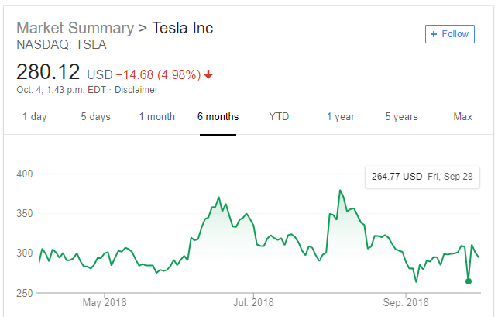
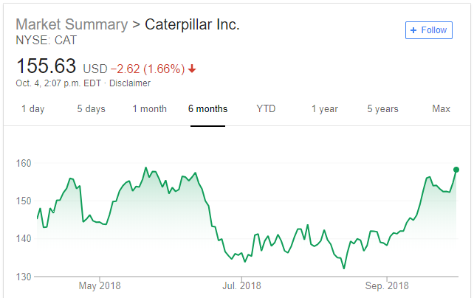
Examples
Tesla- (Auto)
Caterpillar- (Construction)

Slide 4
Short Term (<5 years)
Usually are quick cash grabs
Companies where you stand beside in its slight ups and downs, but when you notice that a substantial change could happen, you would sell
In the short term, stocks can still increase and decrease drastically (+- 10%) .

Slide 5
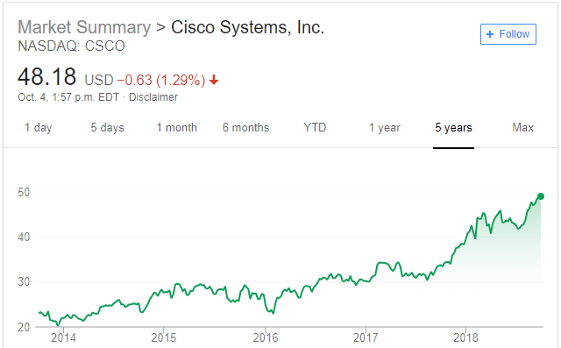
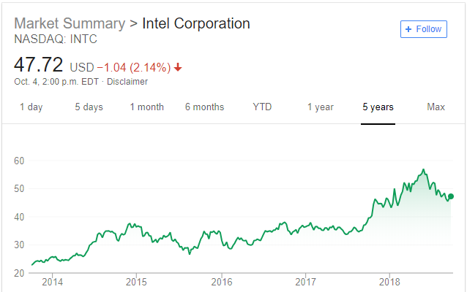
Examples
Cisco- (IT)
Intel- (Consumer Electronics & IT)

Slide 6
Long Term (>5 years)
Companies that will not become obsolete in the next 20 years (e.g. Apple, Amazon, 20th Century Fox, Nike)
Companies you’ve researched and you are confident enough that it will continue to make a steady profit
Stocks like Dow Jones and S&P 500 which hold many companies and if one business does bad, it doesn’t effect much of its own stock
Typically over the long term, stocks steady out to a 7% increase each year

Slide 7
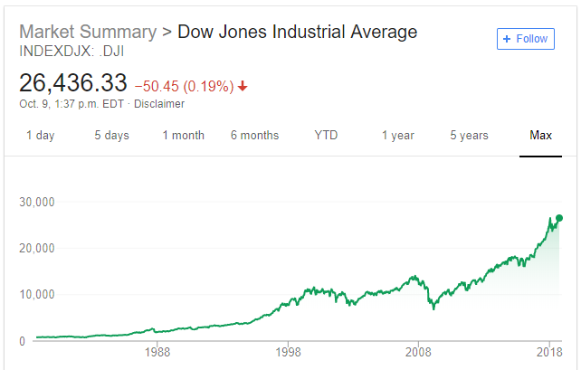
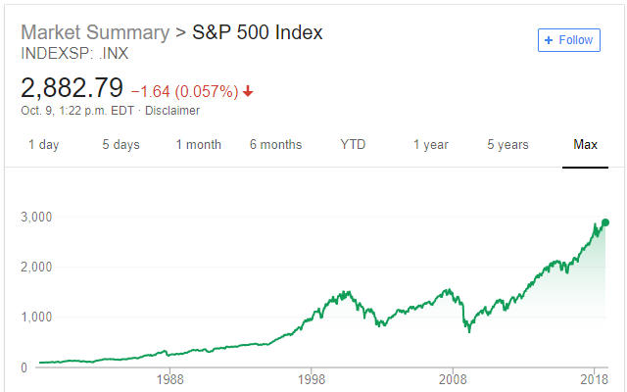
Examples
Dow Jones
S&P 500

Slide 8
Different Strategy Results (average amount earned per day)

Slide 9
Dividends
A percentage of the companies profits are distributed to its shareholders either through extra shares or cold hard cash
Some companies don’t do dividends
Choose companies that have high dividend returns when doing long & short term investments

Slide 10
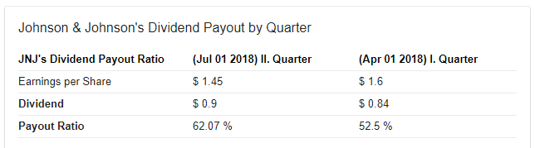
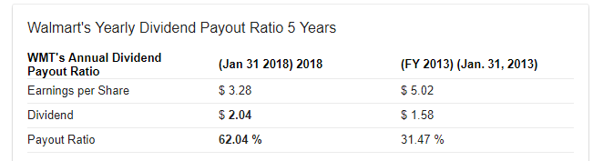
Example
Johnson & Johnson
Walmart

Slide 11
Key Points:
Forget all the numbers we’ve just mentioned because the stock market is VOLITILE!
Invest for the long term if you want to live happily ever after in retirement
Keep your mind open for other investment options
Get educated by a professional on proper stock market etiquette before investing

Slide 12

JOIN OUR KAHOOT @ Kahoot.it!

